Slide 1

Cityscape Image Processing
EE 475 Project – End of December
Gökberk Erdoğan Aydın Uzun

Slide 2
Datasets
Datasets | Number of Images | Image Resolution | Image Size | Purpose
Place Pulse II | 110,988 | 400x300 | ~21kB | Urban Perception
UCF Dataset | 62,058 | 1280x1024 | ~773kB | Image Geo - Localization
Istanbul Dataset | ~800 | Not Fixed | Not Fixed | School Neighborhoods

Slide 3
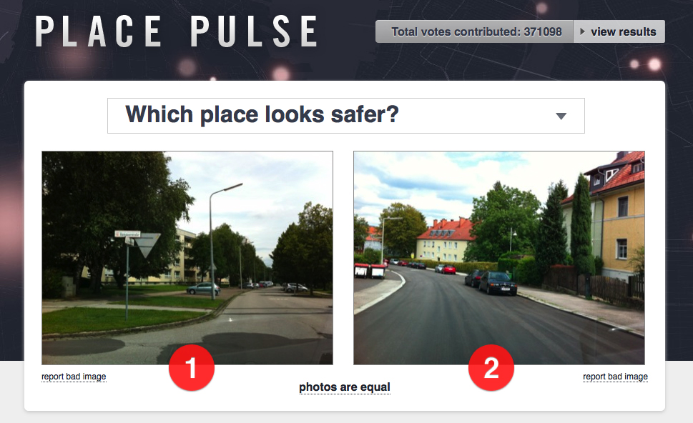
Place Pulse II

Slide 4
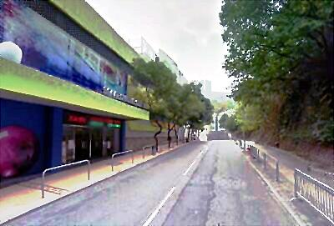
Place Pulse II
6 labels: safe, lively, boring, wealthy, depressing, beautiful
1.17 million comparisons
56 cities
Scoring: TrueSkill

Slide 5
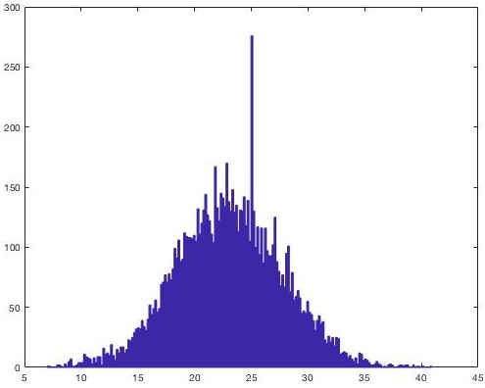
Scores - Safety
Binary Classification
Compare:
MIT Media Lab
Min Score (~10)
Max Score (~35)

Slide 6
Training Set – Test Set
1000 - 100

Slide 7
Pre - Processing
Cropping
Denoising - Wiener Filter
Enhancement - Histogram Equalization
Sharpening

Slide 8
Color Histograms
4 bins
R, G, B
16 sub-blocks
Feature vector length:
4 x 3 x 16 = 192

Slide 9
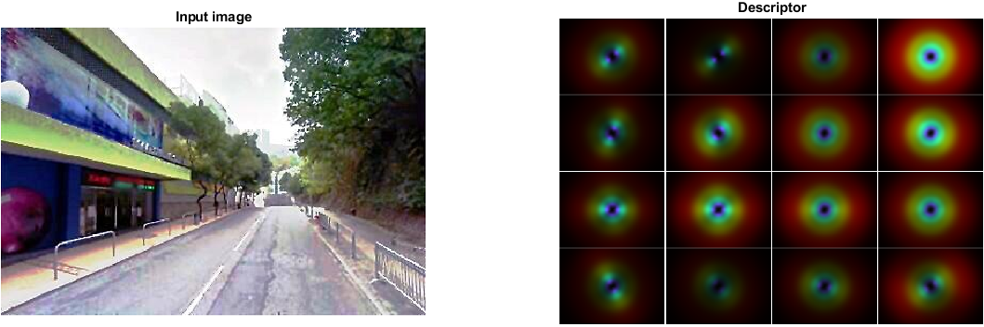
Gist Descriptor
HoG
replace
Gist

Slide 10
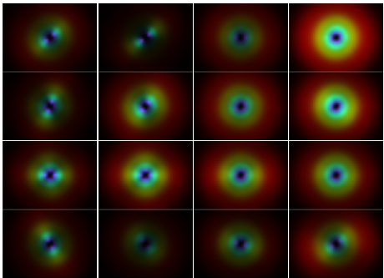
Gist Descriptor
16 subblocks
32 orientations / bins
Feature vector length:
16 x 32 = 512
HoG
replace
Gist

Slide 11
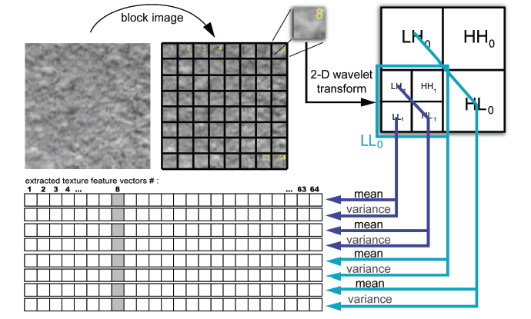
Discrete Wavelet Transform

Slide 12
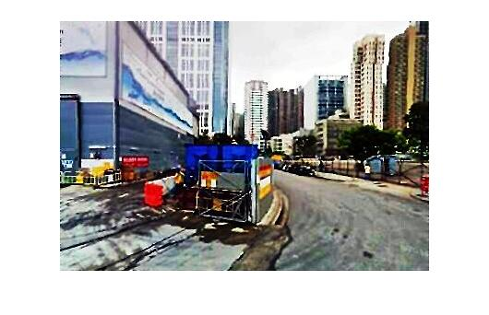
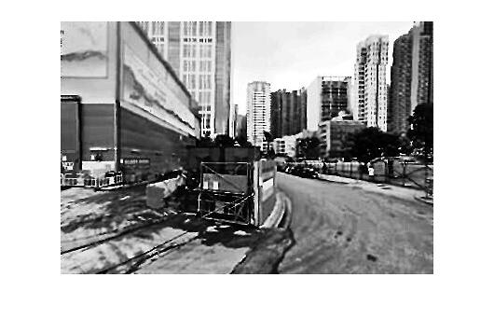
Texture Feature Extraction : an example

Slide 13
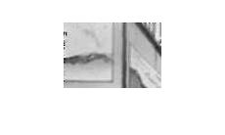
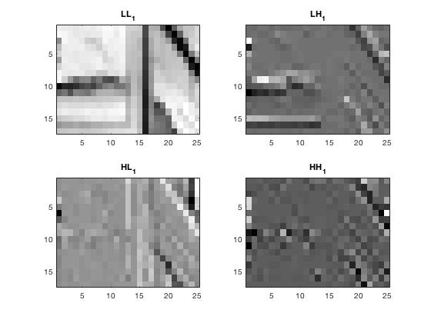
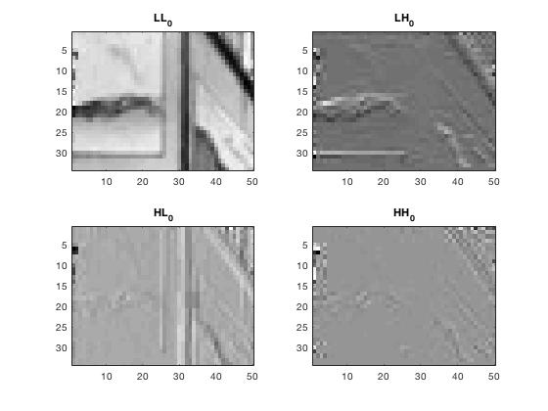

Slide 14
Feature Vectors
Color H. :
Gist D. :
DWT :
1x128
1x192
1x512

Slide 15
Results
Feature: | Color Hist. | Gist Descriptor | Wavelet
Accuracy: | %64 (color108) | %68 | %59
Feature: | Color & Gist | Color & Wave | Gist & Wave
Accuracy: | %69(color48) | %55 | %61
Feature: | Color & Gist & Wavelet
Accuracy: | %61
MIT Media Lab
78.42%

Slide 16
Discussion
En iyi sonucu hangi kombinasyon veriyo ona bakalım
Neden o etiket için bu kombinasyton en iyi sonucu verdi?
Hangi feature-hangi etikete cevap

Slide 17
Bibliography
[1] A. Oliva, A. Torralba. ‘Modeling the shape of the scene: a holistic representation of the spatial envelope’. International Journal of Computer Vision ,2001. 42: 145. https://doi.org/10.1023/A:1011139631724
[2] M. Douze, H. Jégou, H. Sandhawalia, L. Amsaleg, C. Schmid. ‘Evaluation of GIST descriptors for web-scale image search.’ Proceedings of the ACM International Conference on Image and Video Retrieval (CIVR '09). ACM, New York, NY, USA. DOI=http://dx.doi.org/10.1145/1646396.1646421
[3] Pothos, Vasileios & Theoharatos, Christos & Economou, George & Fotopoulos, Spiros. ‘Robust Classification of Texture Images using Distributional-based Multivariate Analysis’. 2008. 10.5772/6077.
[4] Amir Roshan Zamir and Mubarak Shah, "Image Geo-localization Based on Multiple Nearest Neighbor Feature Matching using Generalized Graphs", IEEE Transactions on Pattern Analysis and Machine Intelligence (TPAMI), 2014
[5] Friedman, Alinda. (1979). Framing Pictures: The Role of Knowledge in Automatized Encoding and Memory for Gist. Journal of experimental psychology. General. 108. 316-55. 10.1037/0096-3445.108.3.316.
[6] Raskar, Ramesh & Naik, Nikhil & D. Philipoom, Jade & Hidalgo, Cesar. (2015). Streetscore -- Predicting the Perceived Safety of One Million Streetscapes. IEEE Computer Society Conference on Computer Vision and Pattern Recognition Workshops. 10.1109/CVPRW.2014.121.
[7] Dubey, Abhimanyu & Naik, Nikhil & Parikh, Devi & Raskar, Ramesh & Hidalgo, Cesar. (2016). Deep Learning the City : Quantifying Urban Perception At A Global Scale. 9905. 10.1007/978-3-319-46448-0_12.

